Slide 1
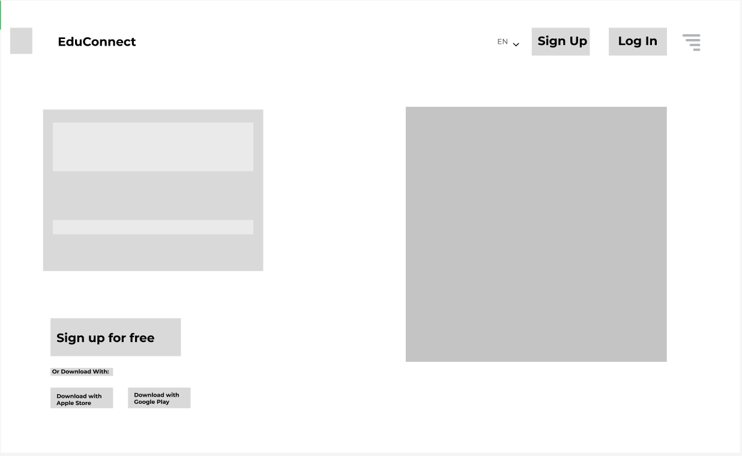
Cover Page

Slide 2
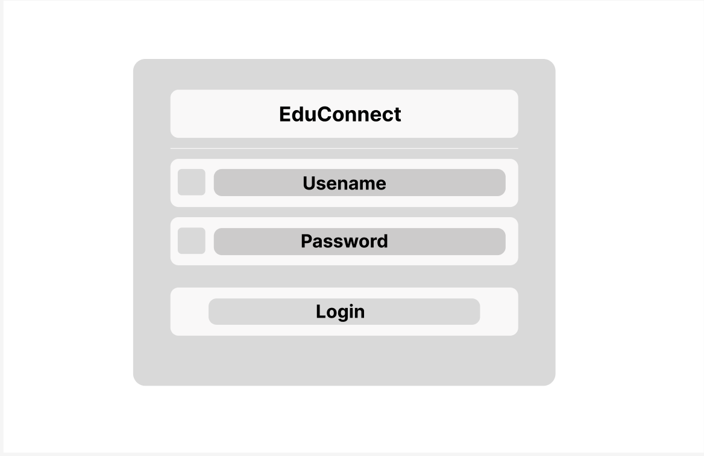
Login Page

Slide 3
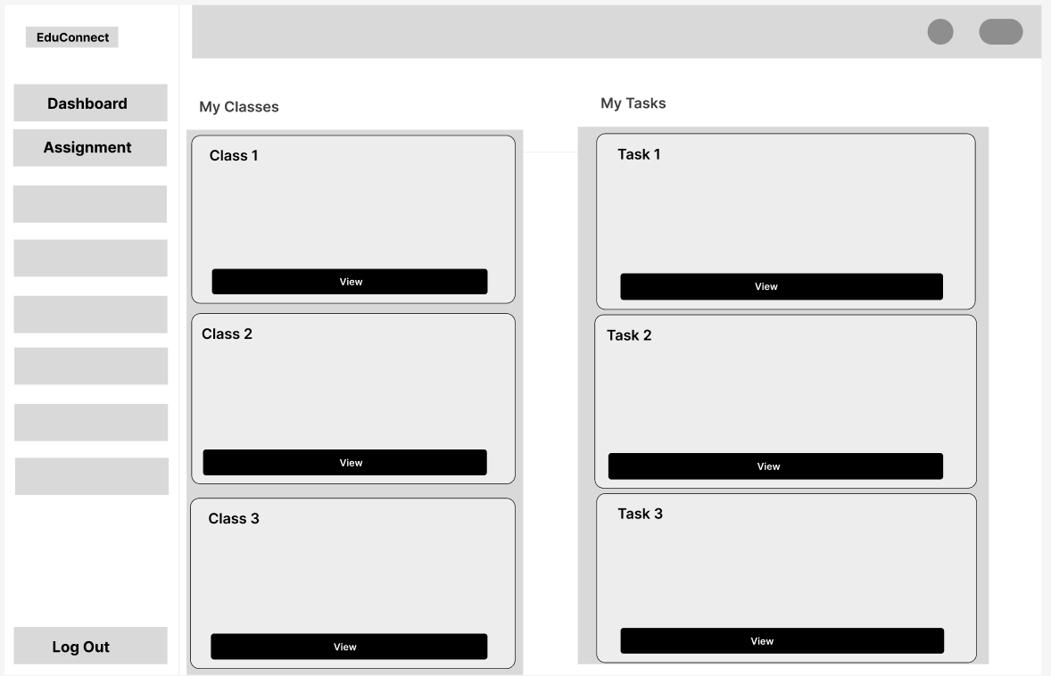
Dashboard

Slide 4
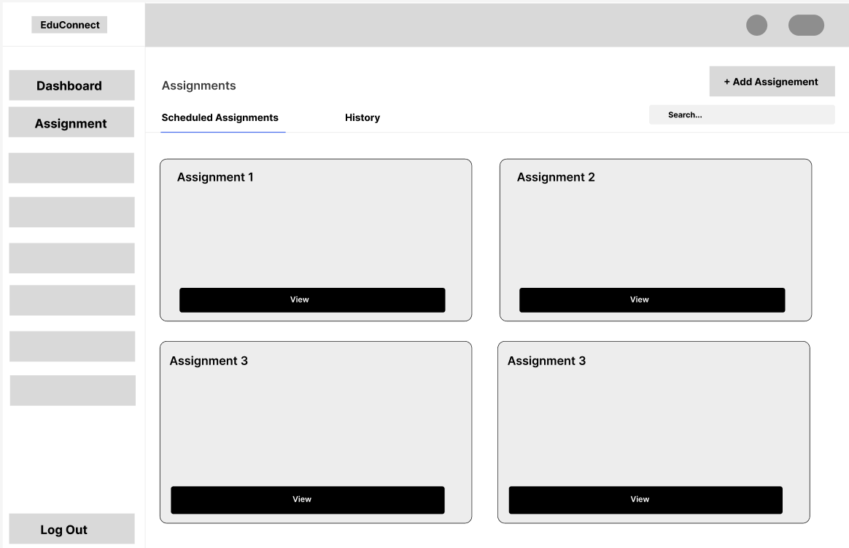
Assignment Information Page

Slide 5
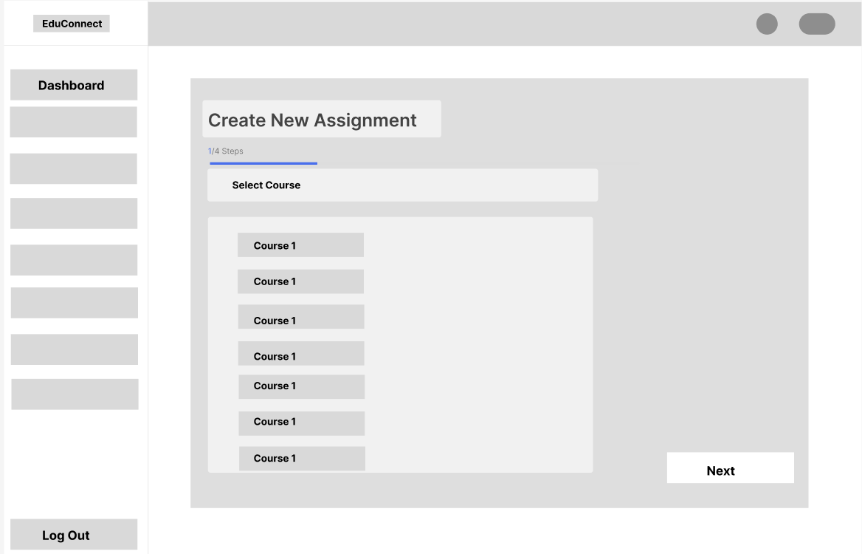
Assignment Creation Page

Slide 6
Assignment Creation Page

Slide 7
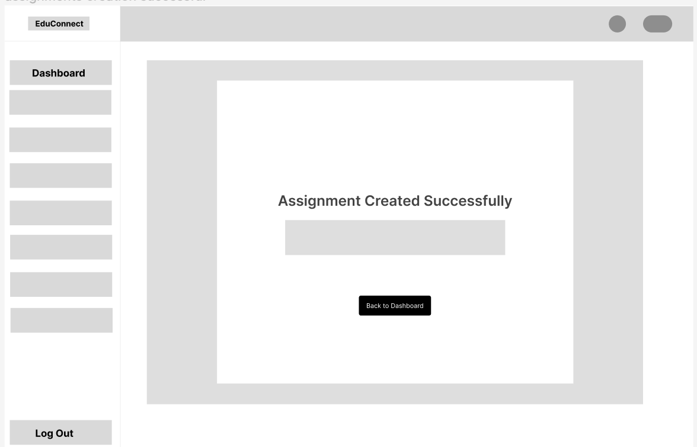
Assignment Creation Successful

Slide 8
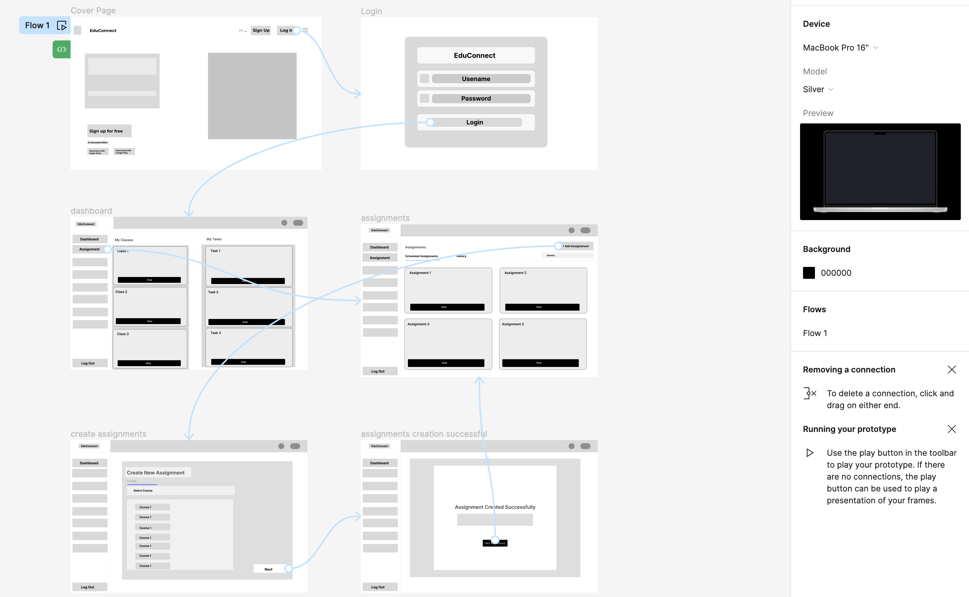
Low-Fidelity Prototype Overview

Slide 9
Low-Fidelity Prototype Animation

